Slide 1
Extrapolative Beliefs in the Cross-section
What Can We Learn from the Crowds?
Zhi Da , Xing Huang , Lawrence Jin
Presentation by Lex Cruise

Slide 2
Introduction
Research in behavioral finance have demonstrated the existence of result extrapolation in investors^{1, 2}
Result extrapolation means investors expect past stock performance to be positively correlated with future performance
This violates “rational” behavior
Further research has demonstrated that that result extrapolation can explain market abnormalities such as excess volatility and return predictability which both violate ‘rational’ investor behavior^{3, 4}
However, testing the hypnosis on a stock level has been difficult because it requires quantifying investor beliefs in an individual stock

Slide 3
Introduction
The growth of FinTech has made aggregating many individual investors beliefs about the stock market much easier
This paper uses a crowdsourced stock ranking website (Forcerank.com) to collect investor beliefs about individual stocks
Forcerank reportedly draws from a large and diverse pool of investors to give a full picture of induvial investors
With this data set the authors investigate how investors expectations of individual stock returns affect asset prices

Slide 4
Method Overview
Model has two types of agent, extrapolators and fundamental traders
Extrapolators create expectation based on past stock performance while fundamental traders arbitrage on mispricing
A linear regression of investor expectation on past stock performance is run, using the stock rank as a proxy for investor expectations
The authors find that past results are important in investor expectation, but the significance of the past results decays exponentially with time
More bias is placed on negative results and negative results are remembered longer

Slide 5
Method Overview
To summarize the degree of extrapolation in the model two parameters are used (λ₁ and λ₂)
λ₁ is a scaling factor applied to all past returns. It is the ‘level’ or magnitude of the extent that investors are sensitive to past returns.
λ₂ is the decay term or the weight investor put on older results compared to newer ones. This represents the ‘slope’ of the extrapolation and the smaller it is the less investor care about older results.
The authors find is λ₁ significantly positive and λ₂ is small as expected
Under ‘rational’ expectations λ₁ should be significantly negative
The magnitude of λ₁ represents magnitude of mispricing

Slide 6
Model
Cross section extrapolation models for behavior finance are uncommon for two main reasons
Data is difficult to collect
The mechanism for how investors create expectations across induvial stocks is not well understood
The authors constructs a very simple model with T+1 periods (t = 0,1,…T) and N+1 assets
N risky assets and 1 risk free asset whose return is normalized to 0

Slide 7
Model
Each asset claims a single terminal dividend payment at T
D_{i,0} is public information at time zero
ε_{M,t} is market news and η_{i,t} is stock idiosyncratic news
ζ_{i} is the loading of stock i on the market news (like a beta)

Slide 8
Model
The price of a stock, P_{i}, is determined by the equilibrium of the model and has fixed supply Q_{i}
µ^{F} is the fraction of fundamental traders and µ^{E} is fraction of extrapolators: µ^{F} + µ^{E} =1
Each type tries to maximize expected utility defined over next period’s wealth with a constant absolute risk aversion coefficient γ

Slide 9
Model
Key assumption of the model is that for a risky asset i
where λ_{i,1} > 0 and λ_{i,2} ∈ (0, 1)
This means extrapolators’ expectation of the change in the price of a risky asset i is a linear function of the weight average of all past price change (the sentiment S_{i,t})

Slide 10
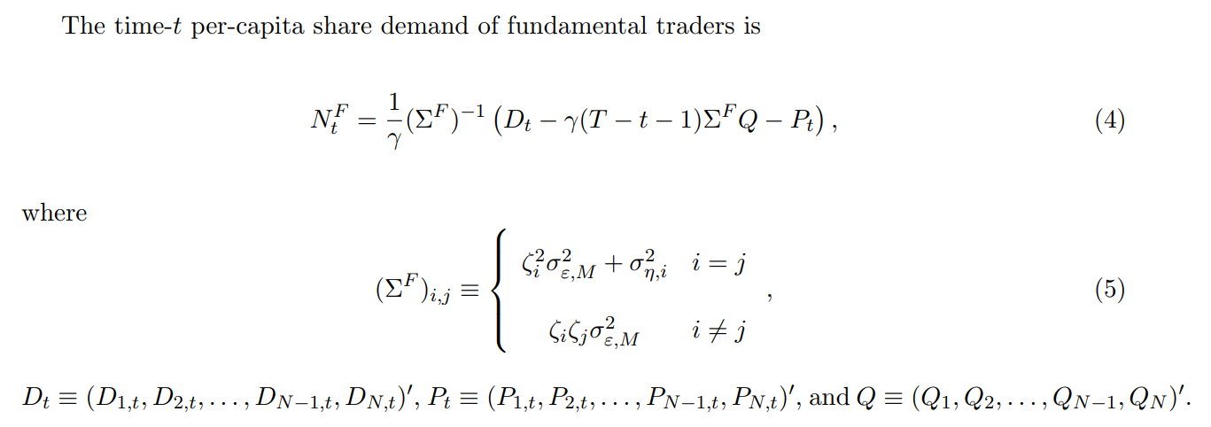
Model

Slide 11
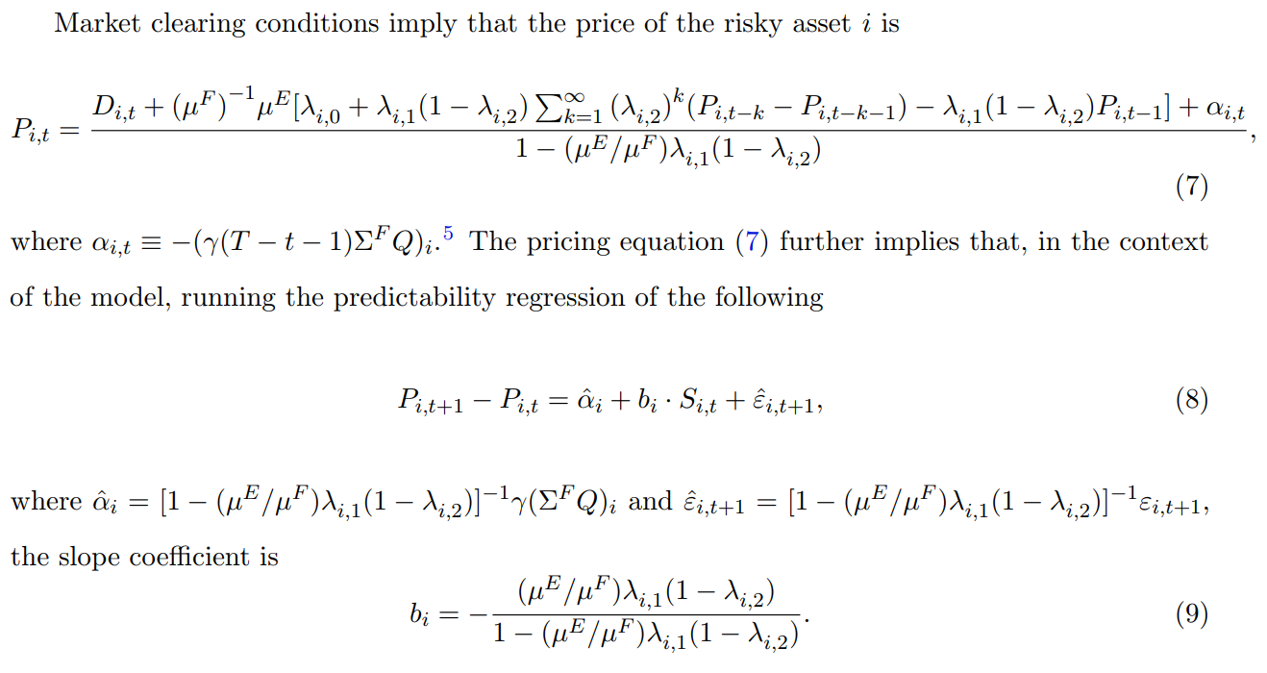
Model

Slide 12
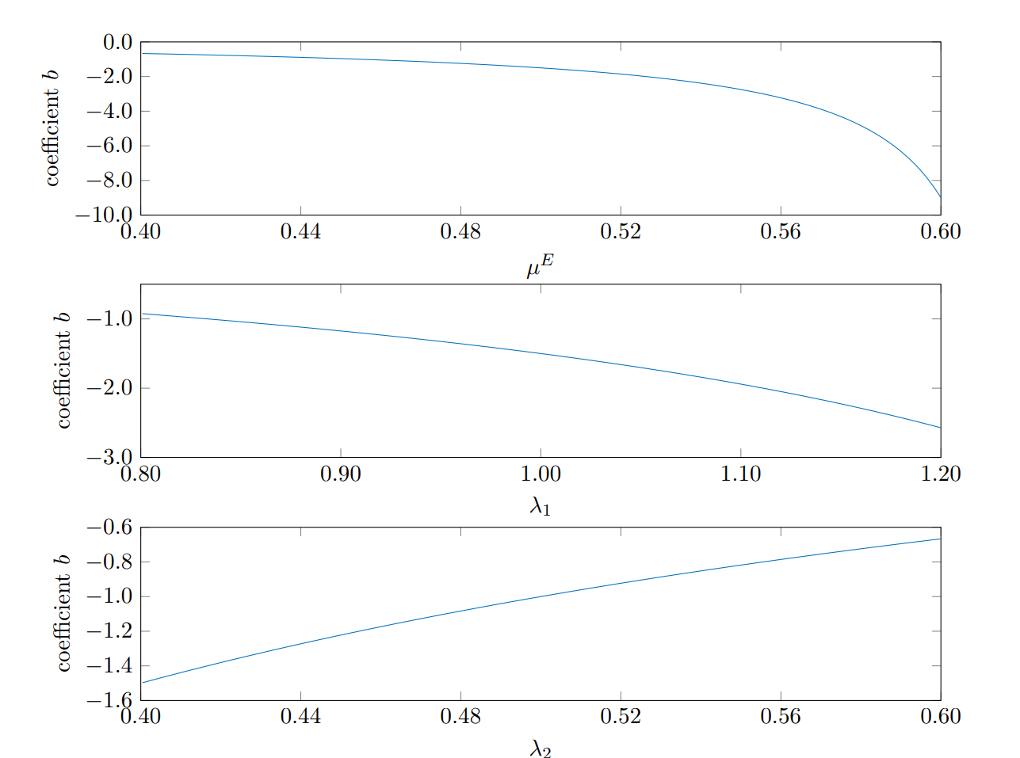
Model
b_{i} relates the total degree of extrapolation to how predictable returns are
A higher µE , λ_{i,1}, or a lower λ_{i,2} increases b_{i} and thus makes i’s returns more predictable

Slide 13
Model Advantages
From equation 8 we know that the return of i is driven by realizations of ε_{i,t}, which have a systematic component ε_{M,t} and a firm-specific component η_{i,t}
Consider a symmetric case where β_{i} ≡ β, σ_{η,i} ≡ σ_{η}, λ_{i,1} ≡ λ₁, λ_{i,2} ≡ λ₂
Then for a equal-weighted market portfolio is must be true that:

Slide 14
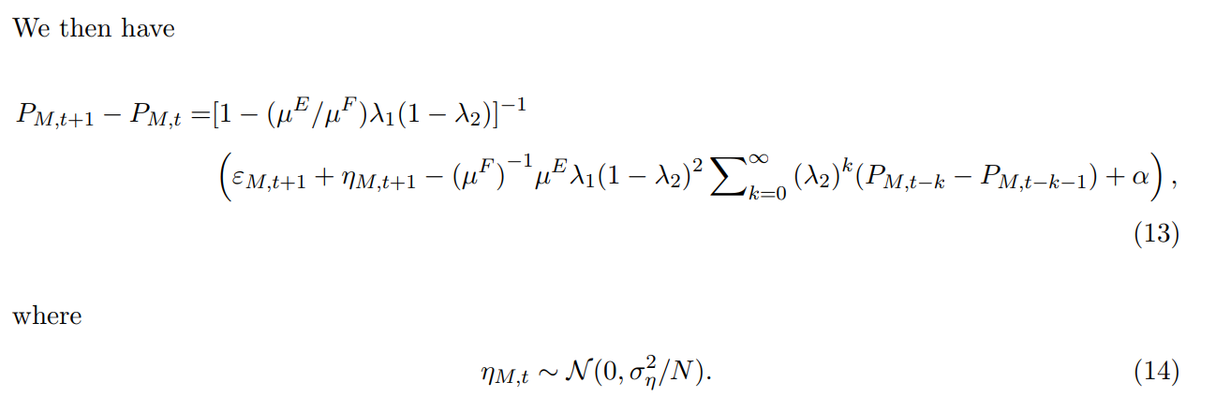
Model Advantages
As N → inf, η_{M,t}→ 0; in words sentiment still negatively affects market returns but it does not depend of the idiosyncratic component of firms’ returns

Slide 15
Empirical Analysis: Expectation Formation
Each week t Forcerank users rank 10 stocks in a sector according to the perceived expected performance in week t+1
For each stock in each sector the authors take an average of the rankings across each user
Highest rank receives a score of 10, second highest receives a score of 9, etc.
Last receives a score of 1

Slide 16
Linear Regression
First a linear model with rank score at the dependent variable and past stock performance as the independent variable
R_{i,t−s} represents the lagged return
w_{s} are the regression coefficients
ε_{i,t} is an error term

Slide 17
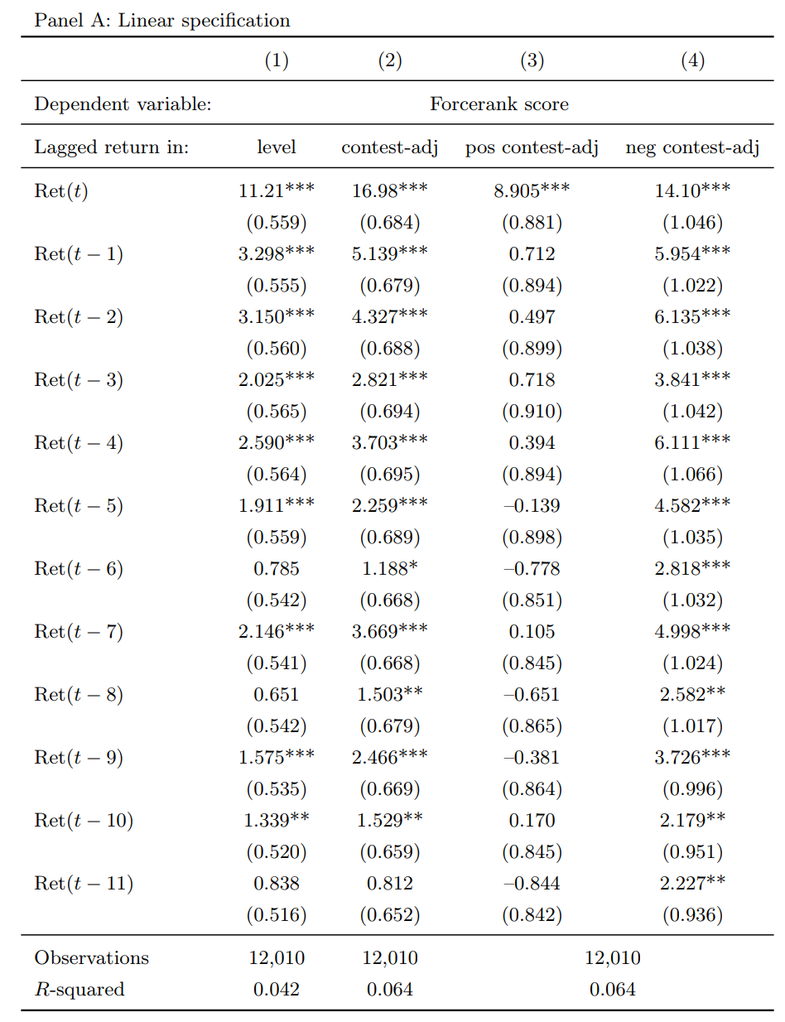
Linear Regression
Column (1) uses the raw level of past returns
Columns (2)-(4) use contest-adjusted returns (that is, the raw return in excess of the contest average return)
Column (3) reports slope coefficients for a regression in which contest-adjust returns in the negative region are set to zero
Column (4) reports slope coefficients for a regression in which contest-adjusted returns in the positive region are set to zero
The standard errors are in parenthesis. “***”, “**”, and “*” represent significance at the 1, 5, and 10% level, respectively

Slide 18
Non-Linear Regression
Noticing the decay in the significance of older returns the authors switch to a non-linear regression that allows for exponential decay
R_{i,t−s} represents the lagged return
w_{s} are the regression coefficients
ε_{i,t} is an error term

Slide 19
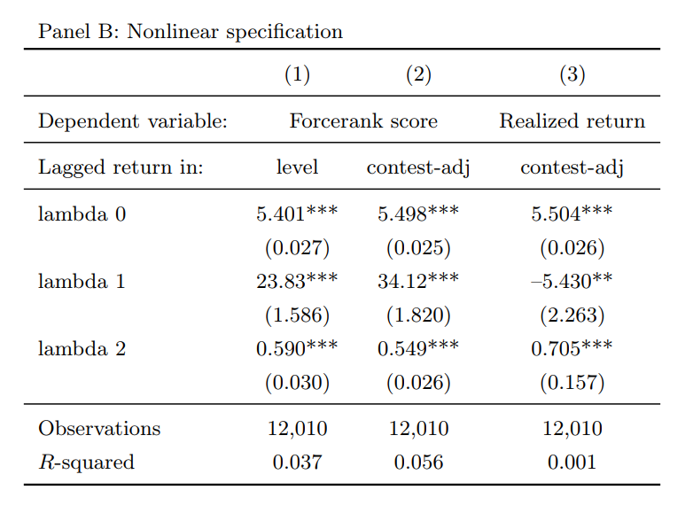
Non-Linear Regression
The λs are as described earlier
Big λ₁ and small λ₂ means more extrapolation
Rational Ranking_{i,t} is the a ranking of stock i over week t computed based on its realized return over week t + 1

Slide 20
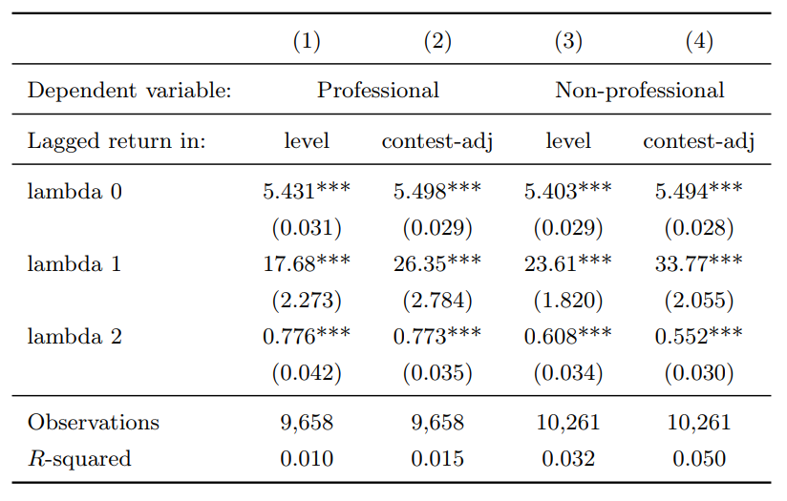
Professional vs. Non-Professional
Because of the cross-sectional nature of the data the authors were able to run the regression on financial professionals and non financial professionals
We can notice a significant difference between the two categories

Slide 21
Return Predictability
In the model return predictability is completely due to behavioral agents extrapolating past returns
As a result, the regression of realized returns on past returns completely recovers the λi,2 parameter of extrapolator beliefs, giving rise to:

Slide 22
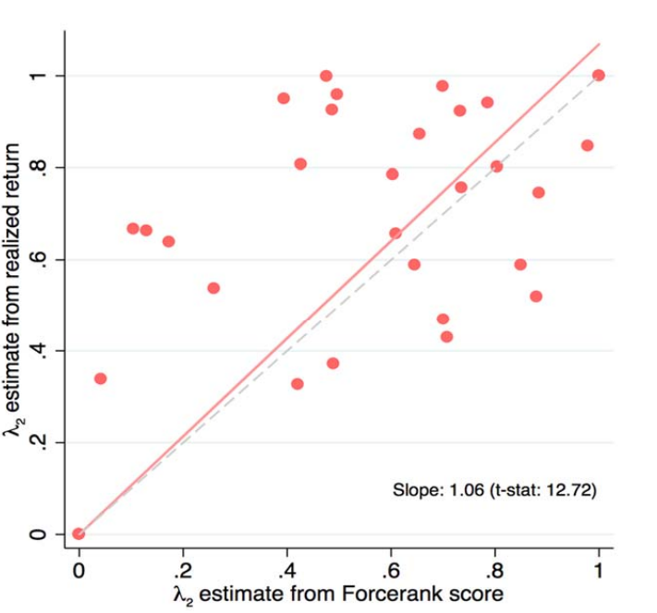
Return Predictability

Slide 23
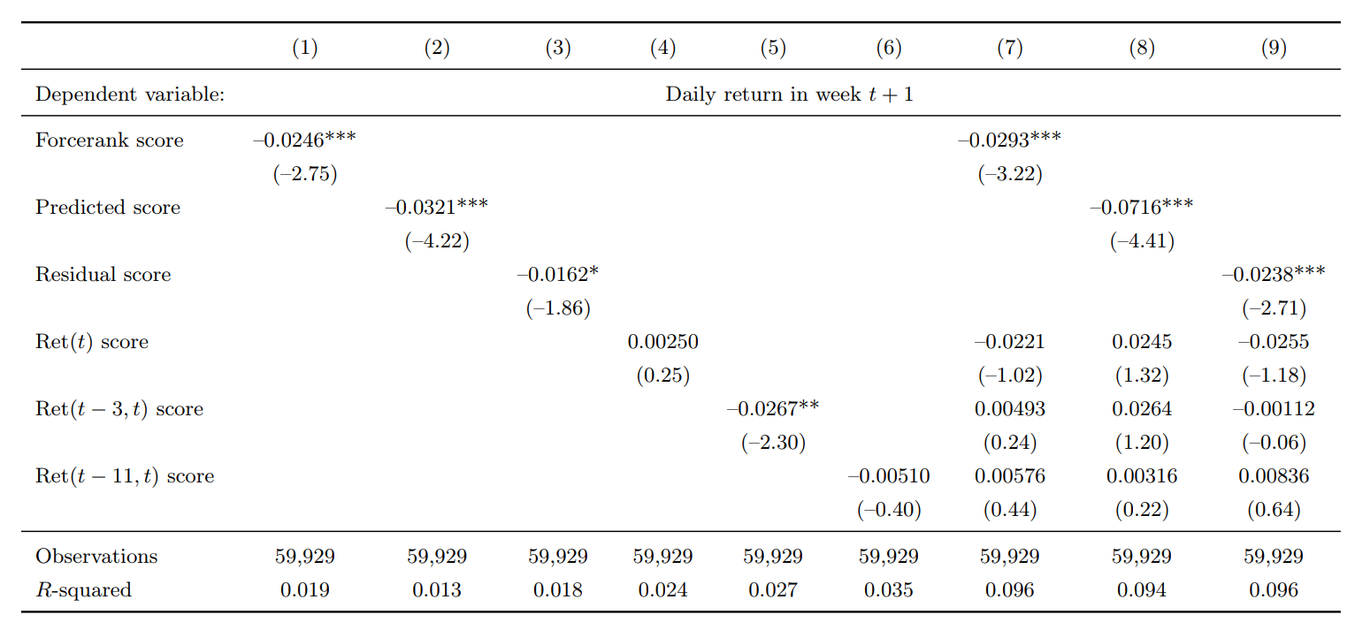
Return predictability of the Forcerank score

Slide 24
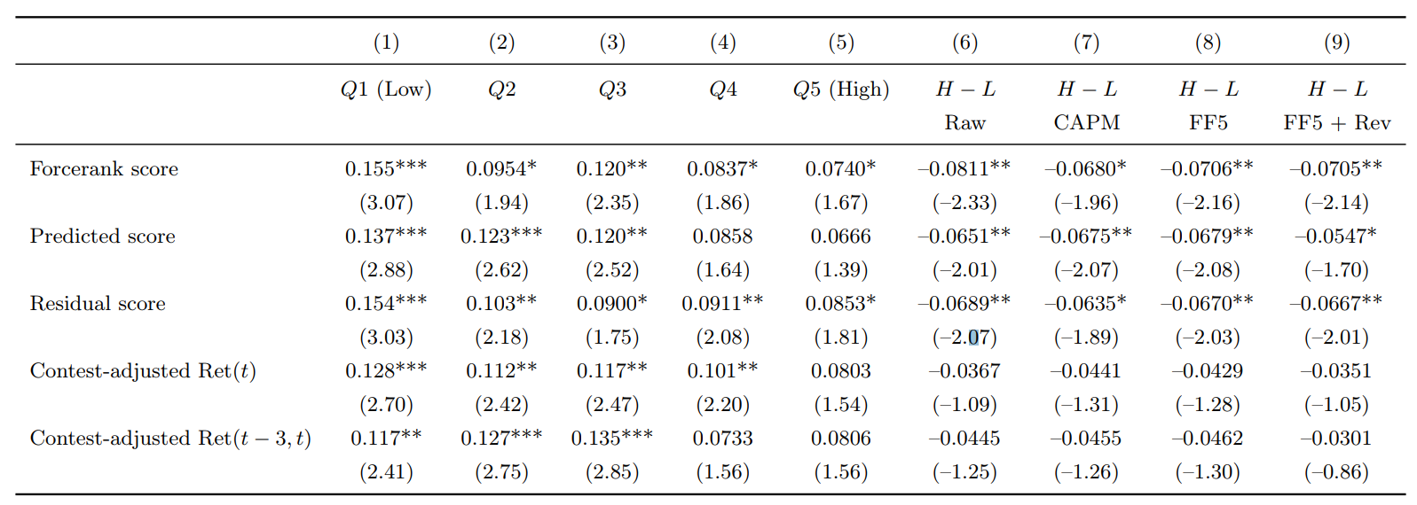
Trading Strategy
At the beginning of each week, sort the stocks on different variables into five quintiles in each contest
The portfolio is rebalanced every week
Stocks whose prices are below five dollars at the beginning of each week are removed

Slide 25
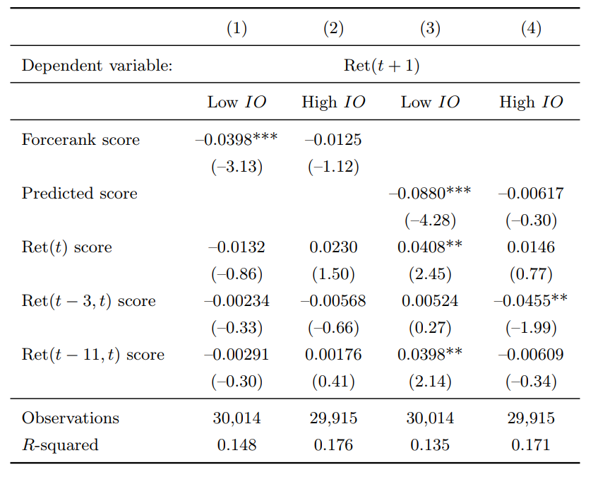
Subsample
This table presents the results of Fama-MacBeth forecasting regressions of individual stock returns
IO stands for institutional ownership
We can see the effect is much more significant for low IO stocks

Slide 26
Out of sample

Slide 27
Conclusion
Authors create a novel data set of investor’s expectation of individual stock returns using the website Forcerank
They model the relation between past returns and investors expectations two different ways
Run regressions and show that past returns are significant factors in investor expectations
Create a predicted score using the regression
Test the predictive power of both the actual score the predicted score
Find both are significant negative predictors of future stock performance
Relate this to Economic model

Slide 28
Critique
My main concerns relate to the Forcerank data set
Sample size is very small, as few 64 people in some sectors, so accuracy of regressions is questionable
User don’t necessarily have to believe the ranking. In normal market data agents ‘put their money where their mouth is’
Users rank stock instead of giving an expectation of return to that must be any additional model/estimation
This is a built in assumption that every user is an extrapolator
The author make of point of noting user geographic and professional diversity, but I am not sure if the users of Forcerank are a good representation of an average extrapolating investor
Authors do note other alternatives and make a reasonable case why Forcerank is preferable, but has Forcerank has since closed down

Slide 29
Critique
Unsure about accuracy of some of the statistics
Regression appears to be accurate with a large sample size because the sample is the market data for the stocks
The output itself is an estimation with a slow sample size
The effect in this is not clear in the statistics
Confusion about the trading strategy
The authors claim that a trading strategy the moves against the sentiment bias is profitable
However they say this is account for a 5 factor trading strategy (which includes momentum) and a short term reversal factor
I would be worried that these factors would be conflated as they measure similar effects

